Slide 1
Chapter 4 Threads

Slide 2
教学内容、目标与要求
教学内容
线程概念
线程模型
线程库
线程问题
教学重点
1、2
教学目标与要求
掌握线程概念；
了解多线程模型及操作系统实例；
理解线程创建、取消、信号传递和接收等问题。

Slide 3
Contents
4.1 Overview
4.2 Multithreading Models
4.3 Threads Libraries
4.4 Threading Issues
4.5 Operating-System examples

Slide 4
4.1 Overview
two characteristics of process:
Resource ownership
process is allocated a virtual address space to hold the process image.
Scheduling/execution
follows an execution path that may be interleaved(交叉) with other processes.
These two characteristics are treated independently by the OS.
Dispatching is referred to as a thread.
Resource ownership is referred to as a process or task.

Slide 5
Overview
A thread, called a lightweight process (LWP), is a basic unit of CPU utilization.
Comprises a thread ID, a program counter, a register set, and a stack.
Shares with other threads belongs to the same process its code section, data section, and other operating-system resources, such as open files and signals.
A traditional (or heavyweight) process has a single thread of control.
If the process has multiple threads of control, it can do more than one task at a time.

Slide 6
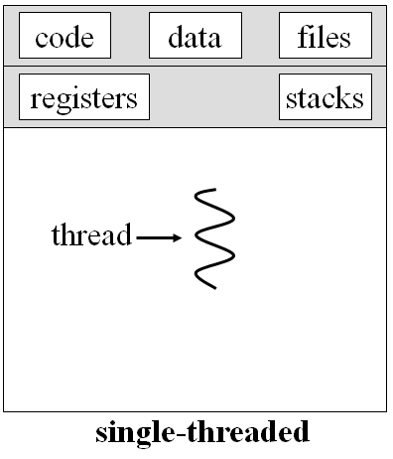
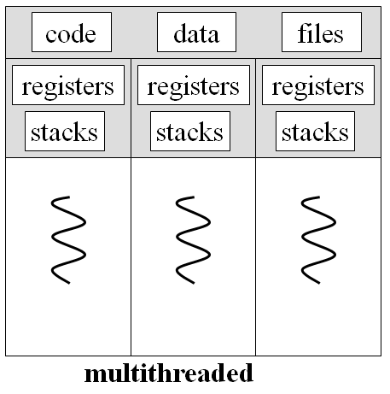
Single-threaded and Multithreaded Processes
since all threads share the same address space
Swapping a process involves swapping all threads of the process.
Termination of a process, terminates all threads within the process.
个体—集体
共享集体的资源；
各自独立的任务；
分工合作完成集体目标；
个人服从集体。
An application typically is implemented as a separate process with several threads of control.

Slide 7
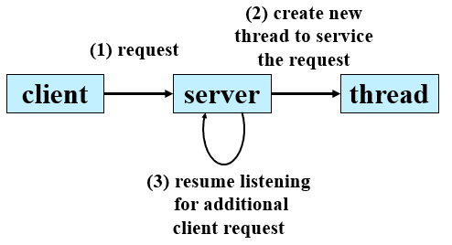
Motivation
Process creation is time consuming and resource intensive.
Process creation is heavy-weight while thread creation is light-weight.
Most modern applications are multithreaded.
E.g. A busy web server
Traditional single-threaded process. run as a single process that accepts requests.
multithreaded, create a separate thread listening for client requests. When a request is made, creates a new thread to service the request and resume listening for additional requests.
Multiple tasks with the application can be implemented by separate threads
Update display, Fetch data, Spell checking, Answer a network request
Can simplify code, increase efficiency
Kernels are generally multithreaded

Slide 8
Benefits of Threads
Responsiveness
may allow continued execution if part of process is blocked, especially important for user interfaces.
Takes less time to create a new thread than a process.
Less time to terminate a thread than a process.
Less time to switch between two threads within the same process.
Since threads within the same process share memory and files, they can communicate with each other without invoking the kernel.
Resource Sharing
Economy
Utilization of MP Architectures
资源共享：内存、文件、I/O设备
效率高：响应快、多处理器

Slide 9
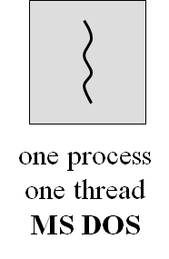
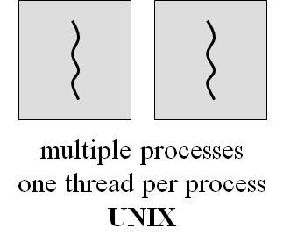
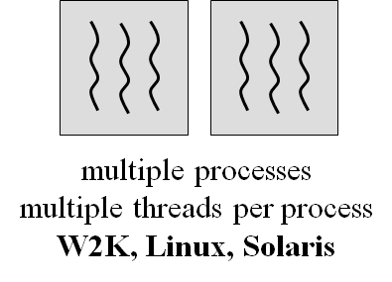
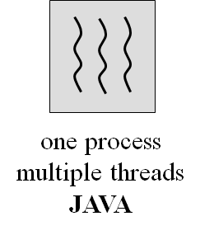
Multithreading
MS-DOS supports a single thread.
UNIX supports multiple user processes but only supports one thread per process.
Windows, Solaris, Linux, Mach, and OS/2 support multiple threads.

Slide 10
Example of Uses of Threads in a Single-User Multiprocessing System
Foreground to background work
Web Browser
Asynchronous processing
Word: edit, automatically save, Spell checking,
An application for data collection and processing
Data accepting, manipulating, saving, outputting
C
M
S
O
C
M
S
O
C
M
S
O
C
M
S
O
……

Slide 11
Threads
Thread States
Running, ready, waiting
operations associated with a change in thread state
Spawn: Spawn another thread
Block, Unblock
Finish: Deallocate register context and stacks
I/O request
I/O complete
Time out
Thread A (P1)
running
waiting
ready
running
ready
Thread B (P1)
ready
running
ready
Thread C (P2)
ready
running
Time out
created

Slide 12
Multicore Programming
Multithreaded programming provides a mechanism for more efficient use of these multiple computing cores and improved concurrency.
E.g. an application with four threads
Concurrent execution on single-core system
Parallelism on a multi-core system:
并发?
并行?

Slide 13
Multicore Programming
Parallelism implies a system can perform more than one task simultaneously.
Concurrency supports more than one task making progress.
Single processor / core, scheduler providing concurrency
CPU designers have improved system performance by adding hardware to improve thread performance.
Modern Intel CPUs frequently support two threads per core.
Oracle T4 CPU supports eight threads per core.
This support means that multiple threads can be loaded into the core for fast switching.

Slide 14
Multicore Programming
Two types of parallelism
Data parallelism – distributes subsets of the same data across multiple cores, same operation on each.
E.g. Summing the contents of an array of size N.
on a single-core system, one thread simply sum the elements [0]…[N-1]
on a dual-core system, thread A, running on core 0, could sum the elements [0]…[N/2-1], thread B, running on core 1, could sum the elements [n/2]…N-1].
Task parallelism – distributing threads across cores, each thread performing unique operation.
Different threads may be operating on the same data, or they may be operating on different data.

Slide 15
Programming Challenges
five areas present challenges in programming for multicore systems:
Identifying tasks. separate, concurrent tasks.
Balance. ensure that the tasks perform equal work of equal value.
Data splitting. the data accessed and manipulated by the separate tasks must be divided to run on separate cores.
Data dependency. When one task depends on data from another, programmers must ensure that the execution of the tasks is synchronized to accommodate the data dependency.
Testing and debugging. When a program is running in parallel on multiple cores, many different execution paths are possible. Testing and debugging such concurrent programs is inherently more difficult.

Slide 16
4.2 Multithreading Models
Support for threads may be provided either at the user level, or by the kernel
User threads, supported above the kernel and are managed without kernel support.
Kernel threads, supported and managed directly by the operating system.
Ultimately, a relationship must exist between user threads and kernel threads.
Three common types of threading implementation
Many-to-One
One-to-One
Many-to-Many

Slide 17
User Threads
Kernel Threads
All thread management is done by the application.
The kernel is not aware of the existence of threads.
User threads are supported above the kernel and are implemented by a thread library at the user level.
The library provides support for thread creation, scheduling, and management with no support from the kernel.
Three primary thread libraries:
POSIX Pthreads
Win32 threads
Java threads
Supported directly by the operating system.
The Kernel performs thread creation, scheduling, and management in kernel space.
Kernel maintains context information for the process and the threads.
Scheduling is done on a thread basis.
Examples of systems supporting kernel threads
Windows XP/2000
Solaris
Linux
Tru64 UNIX
Mac OS X

Slide 18
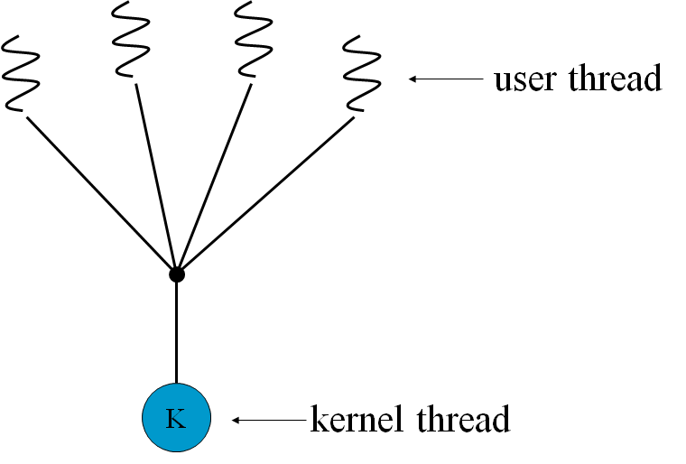
Many-to-One Model
Many user-level threads mapped to single kernel thread.
Thread management is done in user space.
The entire process will block if a thread makes a blocking system call.
Multiple threads are unable to run in parallel on multiprocessors.
because only one thread can access the kernel at a time.
Used on systems that do not support kernel threads.
Few systems currently use this model.
Example of system uses this model
Solaris Green Threads, a thread library available for Solaris 2
GNU Portable Threads

Slide 19
ULT States vs. Process States
thread1
thread2
ready
ready
running
running
ready
ready
running
running
waiting
waiting
Time out
Process A
Issue an I/O request,
Process A is blocked.
ready
ready
running
running
Thread 2 need to coordinate
With Thread 1
waiting
waiting

Slide 20
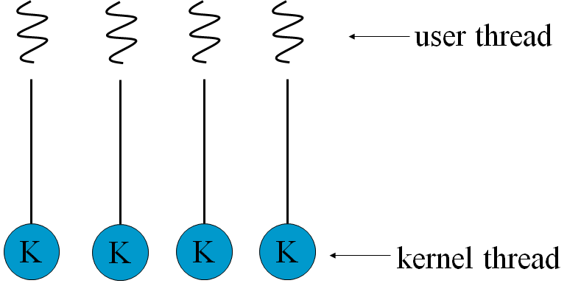
One-to-One Model
Each user-level thread maps to a kernel thread.
Allows another thread to run when a thread makes a blocking system call.
Allows multiple threads to run in parallel on multiprocessors.
Creating a user thread requires creating the corresponding kernel thread.
Restrict the number of threads supported by the system.
Examples of systems using this model
Windows
Linux
Solaris 9 and later

Slide 21
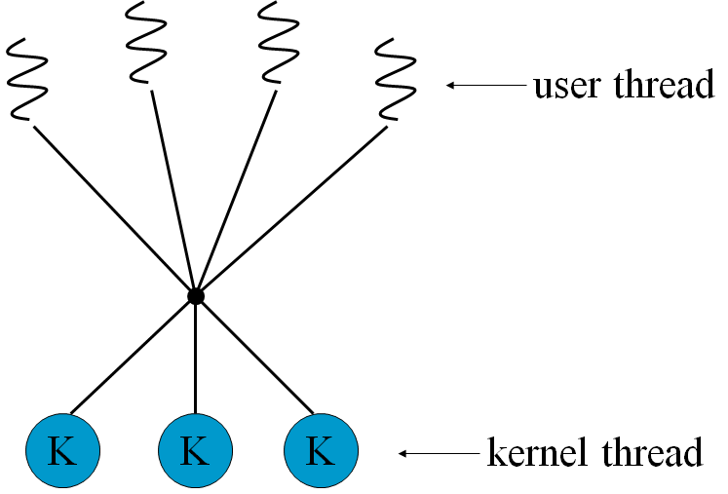
Many-to-Many Model
Allows many user level threads to be mapped to many kernel threads.
Allows the operating system to create a sufficient number of kernel threads.
When a thread performs a blocking system call, the kernel can schedule another thread for execution.
Examples of systems supporting this model
Solaris prior to version 9
Windows with the ThreadFiber package

Slide 22
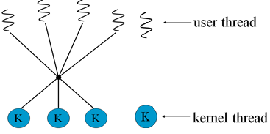
Two-level Model
Similar to M:M, except that it allows a user thread to be bound to a kernel thread.
Examples of systems supporting this model
IRIX
HP-UX
Tru64 UNIX
Solaris 8 and earlier

Slide 23
Comparison of these three models
Many-to-one model
allows the developer to create as many user threads as he wishes；
true concurrency is not gained because the kernel can schedule only one thread at a time.
One-to-one model
allows for greater concurrency
the developer has to be careful not to create too many threads within an application.
Many-to-many model
allows the developer to create as many user threads as necessary；
the corresponding kernel threads can run in parallel on a multiprocessor.

Slide 24
Comparison of these three models
model | 优点 | 缺点
m:1 | 用户自行决定调度算法; 线程切换在用户态，开销小 | 用户进程的多个线程不能并行执行； 用户进程因某个线程阻塞而阻塞。
1:1 | 线程可在不同的CPU上并行处理; 某线程阻塞，其他线程可继续执行 | 线程创建、切换需陷入内核态，开销大； 占用内核资源。
m:n | 上述优点都具备 | 高度复杂，实现困难

Slide 25
4.3 Thread Libraries
Provides the programmer with an API for creating and managing threads.
Two primary ways of implementing
Provides a library entirely in user space with no kernel support. (-- local function call) All code and data structures exist in user space.
Implement a kernel-level library supported directly by the OS. (-- system call) All code and data structures exist in kernel space.
Main thread library
POSIX Pthreads
Win32
Java

Slide 26
Global data and local data
For POSIX and Windows threading
Any data declared globally are shared among all threads belonging to the same process. Because Java has no notion of global data, access to shared data must be explicitly arranged between threads.
Data declared local to a function are typically stored on the stack. Since each thread has its own stack, each thread has its own copy of local data.

Slide 27
Strategies for Creating Multiple Threads
Two general strategies:
asynchronous threading
synchronous threading.
Asynchronous threading
once the parent creates a child thread, the parent resumes its execution, so that the parent and child execute concurrently.
used in the multithreaded server.

Slide 28
Strategies for Creating Multiple Threads
Synchronous threading.
when the parent thread creates one or more children and then must wait for all of its children to terminate before it resumes. --- the so-called fork-join strategy.
the threads created by the parent perform work concurrently, but the parent cannot continue until this work has been completed.
Once each thread has finished its work, it terminates and joins with its parent.
Only after all of the children have joined can the parent resume execution.
Typically, synchronous threading involves significant data sharing among threads. e.g. the parent thread may combine the results calculated by its various children.

Slide 29
Pthreads
POSIX standard (IEEE 1003.1c) defining an API for thread creation and synchronization.
Portable Operating System Interface of UNIX
Pthreads, the extension of the POSIX standard.
Provided as either a user-level or kernel-level library.
Specification, not implementation
API specifies behavior of the thread library, implementation is up to development of the library.
Common in UNIX and Linux operating systems.
Referred to user-level library. Because no distinct relationship exists between a thread created using the Pthread API and any associated kernel threads.

Slide 30
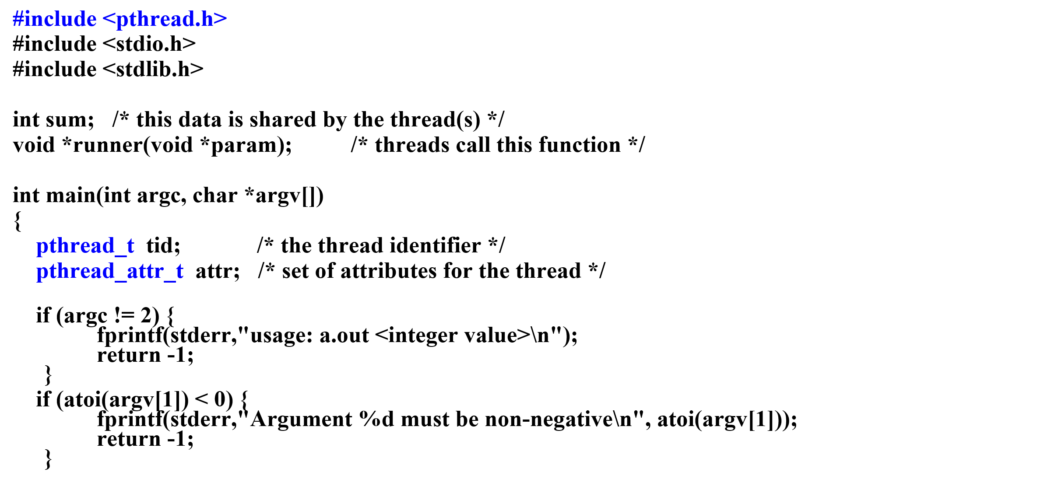
Multithreaded C program using the Pthreads API

Slide 31
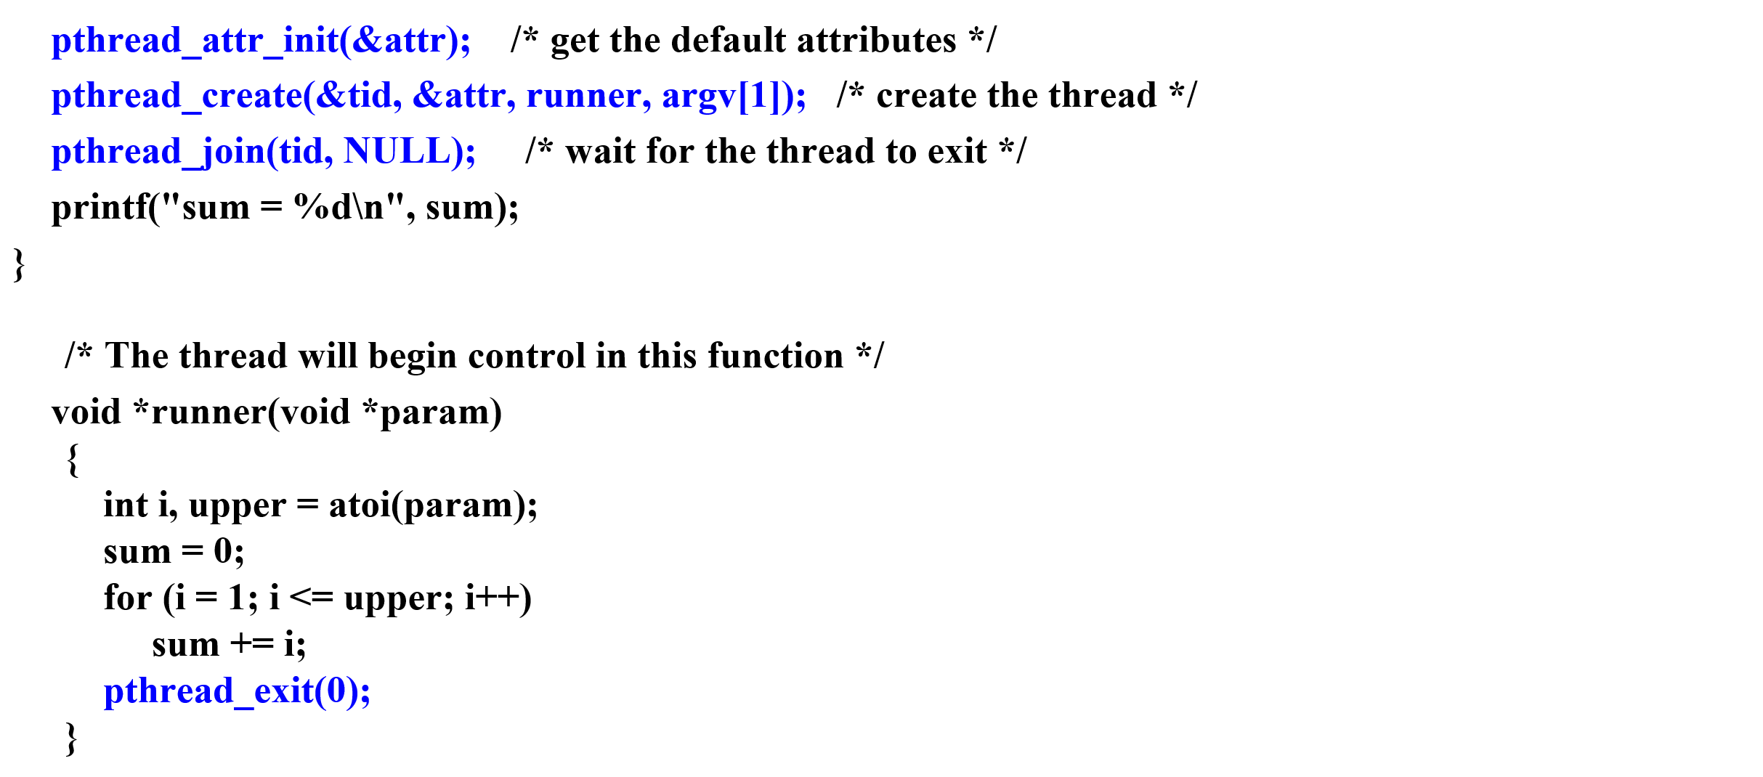
Multithreaded C program using the Pthreads API

Slide 32
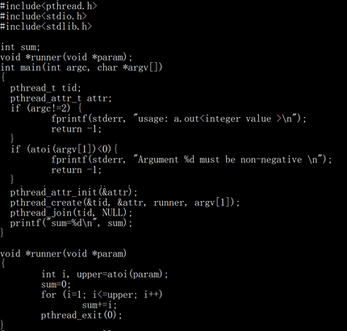
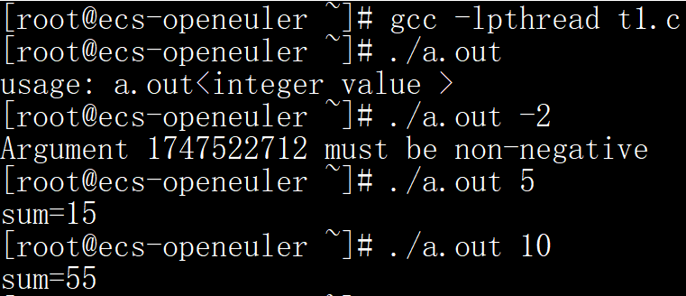
Example 1: creates 1 thread

Slide 33
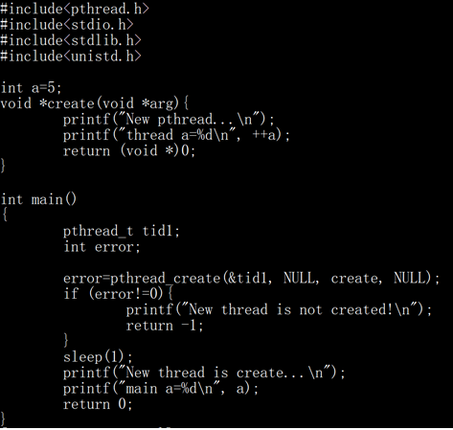
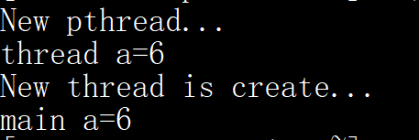
Example 2:

Slide 34
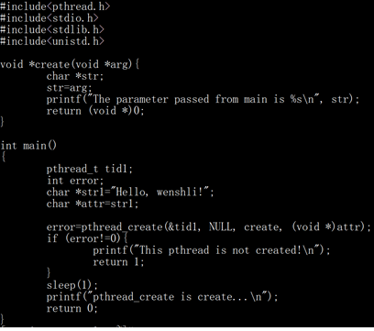
Example 3:

Slide 35
Wait for multiple child threads
method for waiting on several threads using the pthread_join() function is to enclose the operation within a simple for loop.
Pthread code for joining ten threads
#define NUM_THREADS 10
/* an array of threads to be joined upon */
Pthread_t workers[NUM_THREADS];
for (int i = 0; i < NUM_THREADS; i++)
pthread_join(workers[i], NULL);

Slide 36
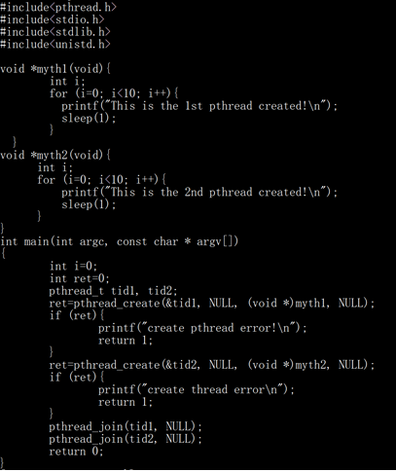
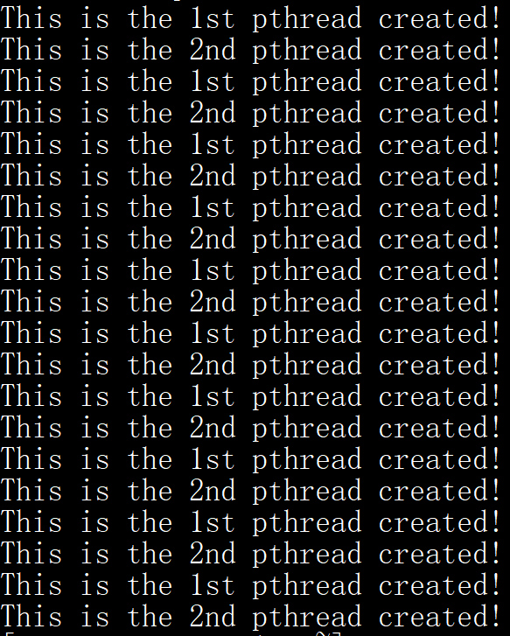
Example 4: creates 2 threads

Slide 37
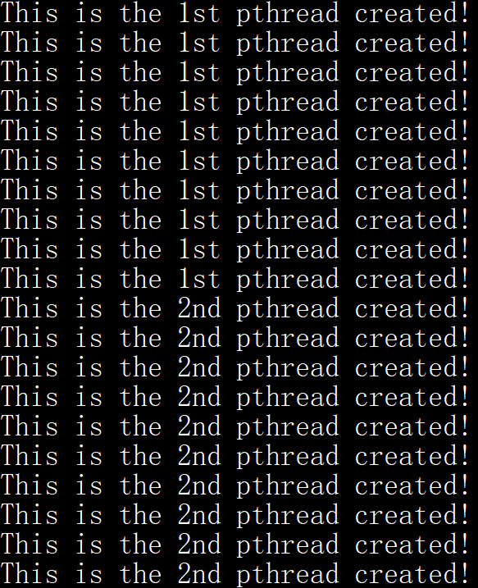
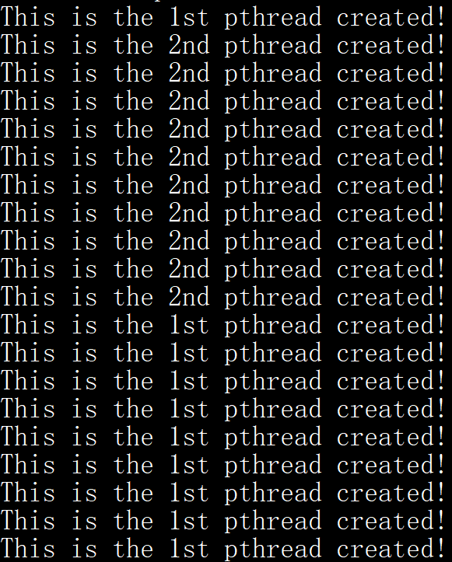
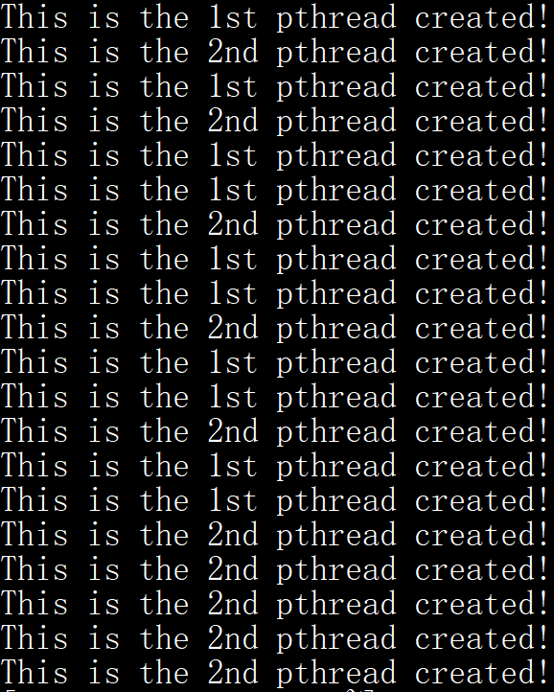
Example 4: creates 2 threads
No sleep()
myth1, sleep(1)
Myth2, no sleep
myth1, sleep(1)
Myth2, sleep(2)

Slide 38
Windows threads
A kernel-level threads library available on Windows systems.

Slide 39
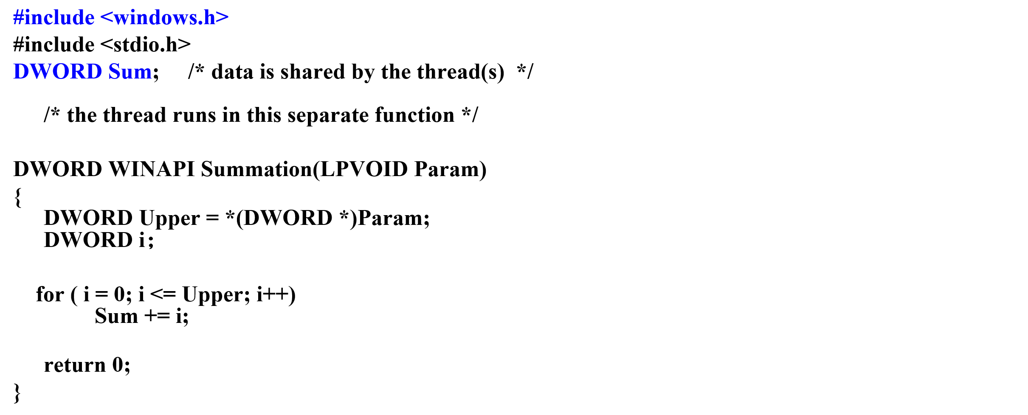
Multithreaded C program using Windows API

Slide 40
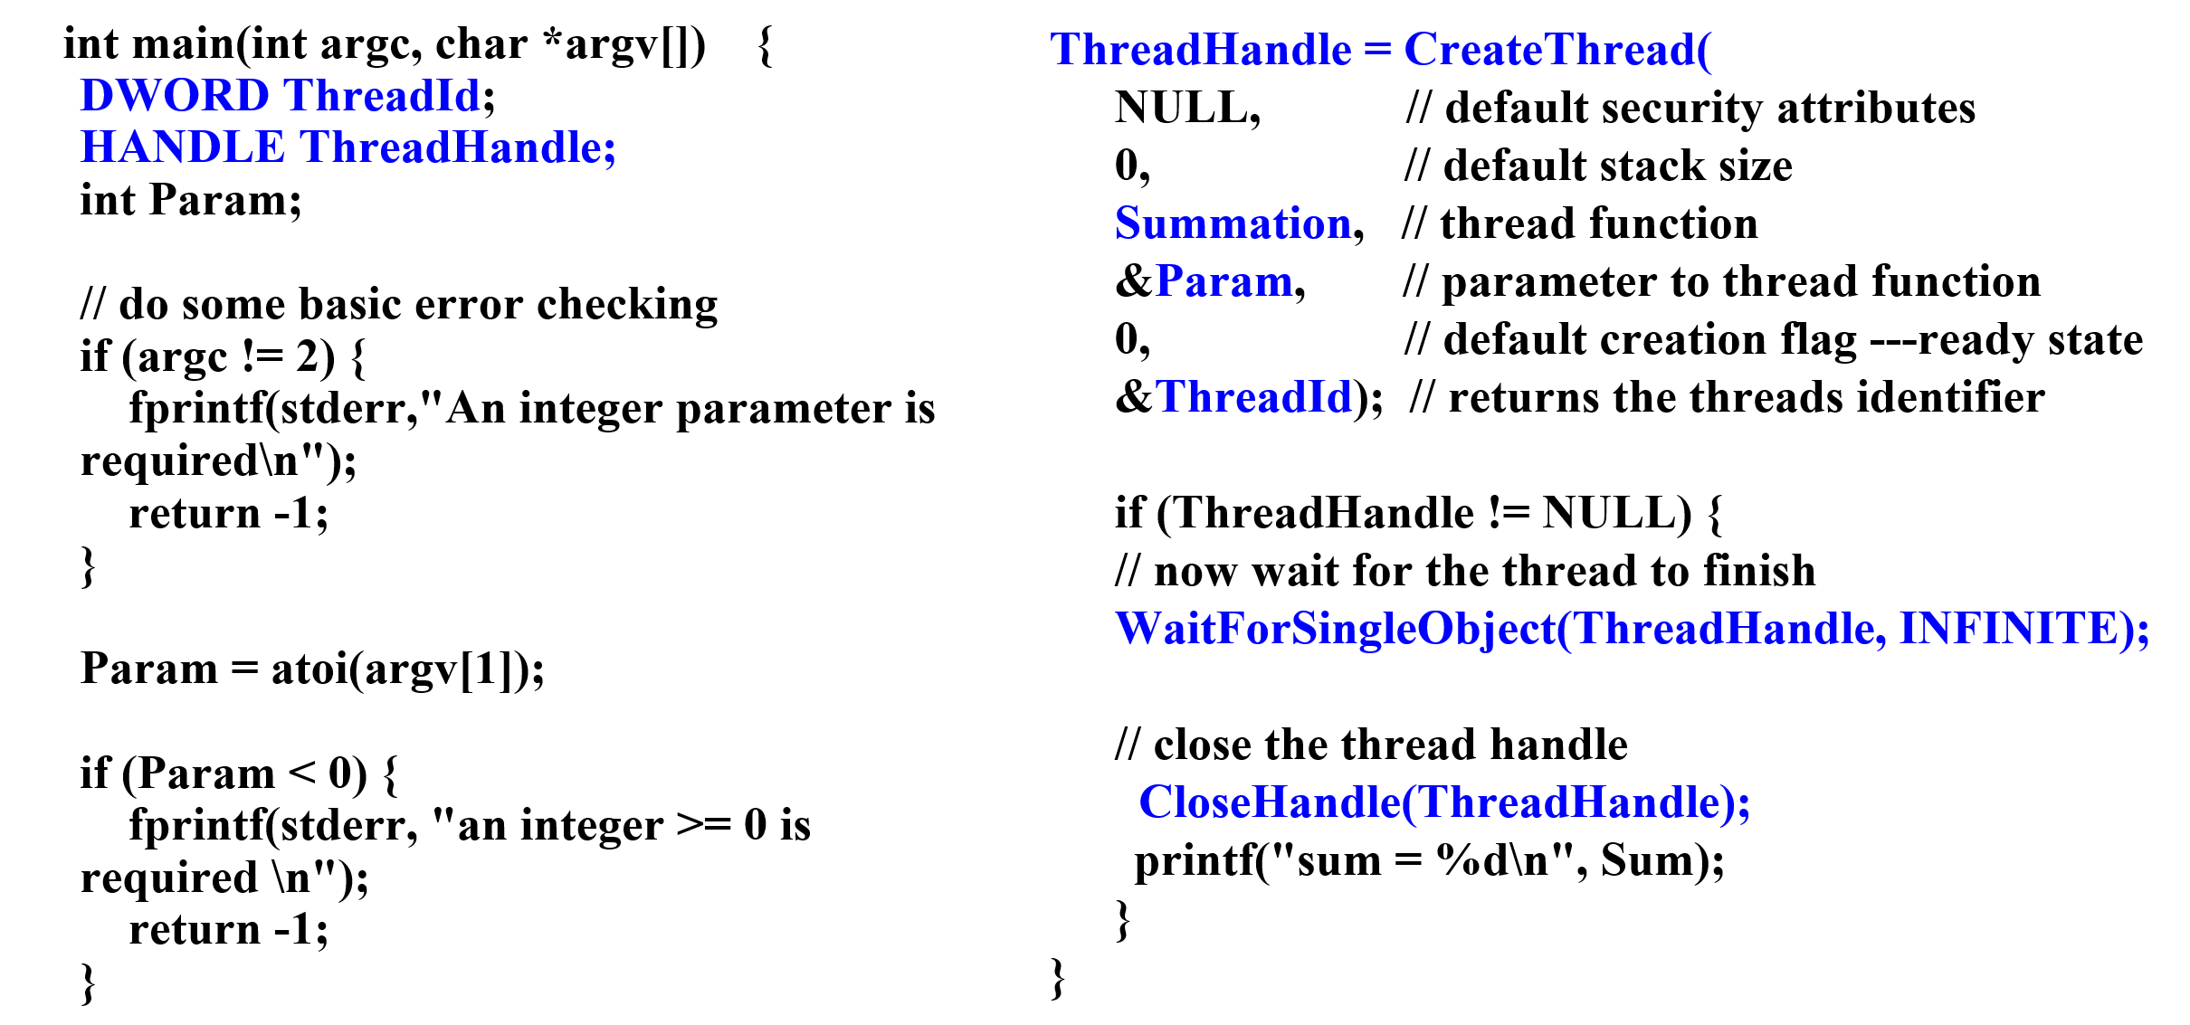
Multithreaded C program using Windows API
sum

Slide 41
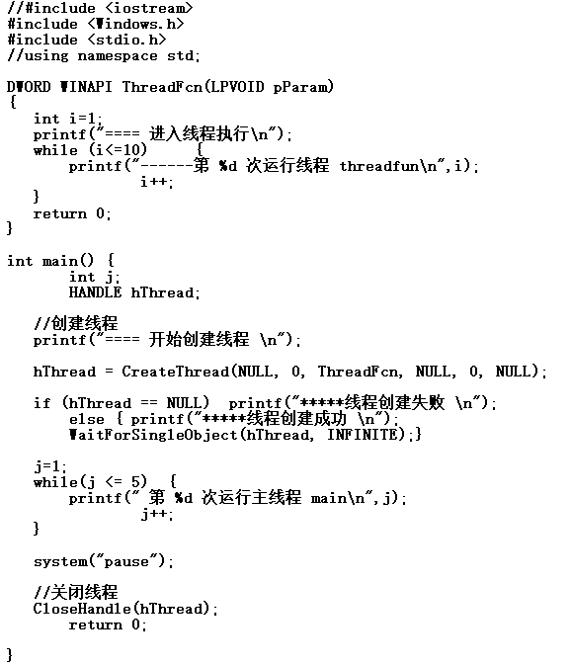
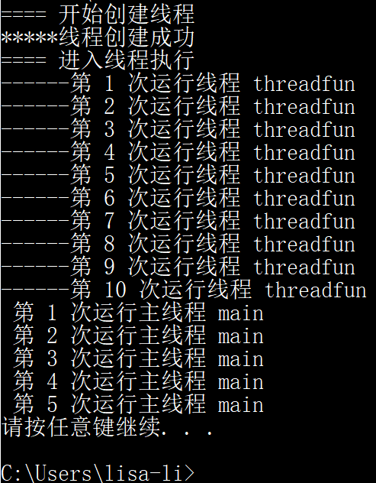
Example 5: WaitForSingleObject

Slide 42
Wait for multiple child threads
WaitForMultipleObjects()
Four parameters:
1. The number of objects to wait for
2. A pointer to the array of objects
3. A flag indicating whether all objects have been signaled
4. A timeout duration (or INFINITE)
For example, if THandles is an array of thread HANDLE objects of size N, the parent thread can wait for all its child threads to complete with this statement:
WaitForMultipleObjects(N, THandles, TRUE, INFINITE);

Slide 43
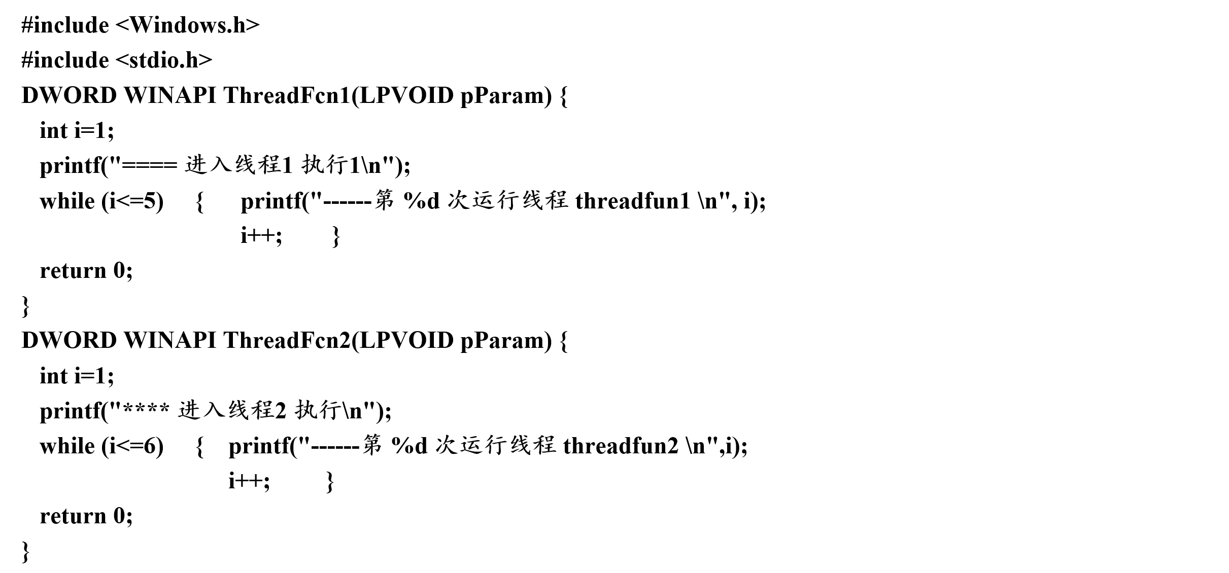
Example 6: WaitForMultipleObjects

Slide 44
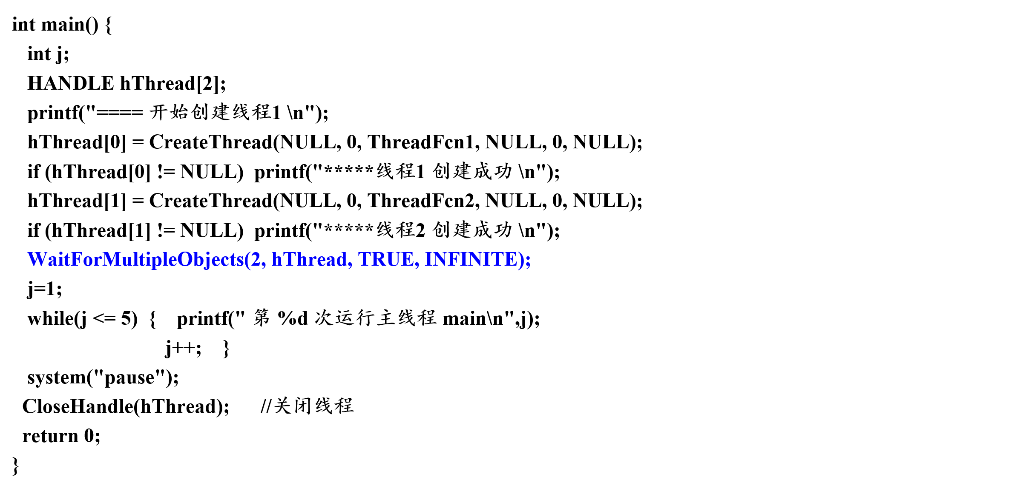
Example 6: WaitForMultipleObjects
Waitfor 2 threads

Slide 45
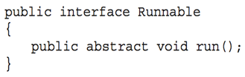
Java Threads
Java provides support at the language level for the creation and management of threads.
Java threads are managed by the JVM.
All Java programs comprise at least a single thread of control.
Two techniques for creating threads in a Java program:
Extending Thread class create a new class that is derived from the Thread class and to override its run() method.
Define a class that implements the Runnable interface
When a class implements runnable, it must define a run() method.
The code implementing the run() method is what runs as a separate thread.

Slide 46
Java Thread States
runnable
start( )
stop( )
sleep( )
suspend( )
I/O
new
new
dead
resume( )
blocked

Slide 47
4.4 Threading Issues
The fork() and exec() system calls
cancellation
Signal handling
Thread pools
Thread specific data
Scheduler Activations

Slide 48
1. The fork() and exec() system calls
If one thread in a program calls fork(), does the new process duplicate all threads or is the new process single-threaded?
Duplicates all threads
duplicates only the thread that invoked the fork() system call.
If exec() is called immediately after forking, duplicating only the calling thread is appropriate.
If a thread invokes the exec() system call, the program specified in the parameter to exec() will replace the entire process, including all threads.
If the separate process does not call exec() after forking, the separate process should duplicate all threads.

Slide 49
2. Thread cancellation
Terminates a thread before it has completed.
Two different scenarios to cancel a target thread
Asynchronous cancellation: one thread immediately terminates the target thread.
Deferred cancellation: the target thread periodically check if it should terminate.
The difficulty with cancellation occurs in situations:
resources have been allocated to a cancelled thread.
thread was cancelled while in the middle of updating data it is sharing with other threads.
Most operating systems allow a process or thread to be cancelled asynchronously.
Pthread API provides deferred cancellation.

Slide 50
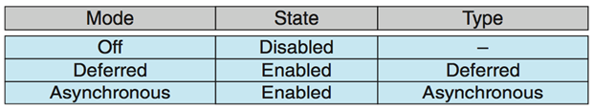
Thread cancellation
Pthread code to cancel a thread: pthread_cancel(tid);
Invoking pthread_cancel(tid) requests cancellation, but actual cancellation depends on thread state:
A thread may set its cancellation state and type using an API.
If thread has cancellation disabled, cancellation remains pending until thread enables it.
Default type is deferred.
Cancellation only occurs when thread reaches cancellation point
i.e. pthread_testcancel()， create a cancellation point
then cleanup handler is invoked, resources be released
On Linux, thread cancellation is handled through signals

Slide 51
3. Signal handling
A signal is used in UNIX systems to notify a process that a particular event has occurred.
A signal may be received either synchronously or asynchronously, depending on the source and the reason.
All signals follow the same pattern:
A signal is generated by the occurrence of a particular event.
A generated signal is delivered to a process.
Once delivered, the signal must be handled.

Slide 52
Signal handling
Synchronous signal:
E.g. illegal memory access, division by 0.
Synchronous signals are delivered to the same process that performed the operation that caused the signal.
Asynchronously signal:
E.g terminating a process with specific keystrokes, Ctrl+C
When a signal is generated by an event external to a running process, that process receives the signal asynchronously.
Every signal may be handled by one of two possible handlers
a user-defined signal handler
a default signal handler, which is run by the kernel

Slide 53
Signal handling
In multithreaded programs, a signal should be delivered to
the thread to which the signal applies.
every thread in the process.
certain threads in the process.
a specific thread which is assigned to receive all signals for the process.
The method delivering a signal depends on signal type.
Synchronous signals need to be delivered to the thread that generated the signal and not to other threads in the process.
Some asynchronous signals should be sent to all threads, e.g. Ctrl+C
Some asynchronous signals may be delivered to only those threads that are not blocking the signal. (Some multithreaded versions of UNIX allow a thread to specify which signals it will accept and which it will block.)

Slide 54
4. Thread pools
Idea:
Create a number of threads at process startup and place them into a pool, where they sit and wait for work.
When a server receives a request, it awakens a thread from this pool, passing it the request to service.
Once the thread completes its service, it returns to the pool awaiting more work.
If the pool contains no available thread, the server waits until one becomes free.
Benefits of thread pool
usually faster to service a request with an existing thread than waiting to create a thread.
Allows the number of threads in the application to be bound to the size of the pool.

Slide 55
5. Thread-specific data
Threads belonging to a process share the data of the process.
Thread-specific data allows each thread to have its own copy of data (Thread-local storage (TLS) ).
Useful when you do not have control over the thread creation process (i.e., when using a thread pool)
In a transaction-processing system, we might service each transaction in a separate thread. Each transaction may be assigned a unique identifier. To associate each thread with its unique identifier we could use thread-local storage (Thread-specific data).
Different from local variables
Local variables visible only during single function invocation
TLS visible across function invocations
Similar to static data
Thread-specific data is unique to each thread.

Slide 56
POSIX API
pthread_key_create：创建一个键
int pthread_key_create(pthread_key_t *key, void (*destr_function) (void*));
pthread_setspecific：为指定键值设置线程私有数据
int pthread_setspecific(pthread_key_t key, const void *pointer);
pthread_getspecific：从指定键读取线程的私有数据
void * pthread_getspecific(pthread_key_t key);
pthread_key_delete：删除一个键
int pthread_key_delete(pthread_key_t key);

Slide 57
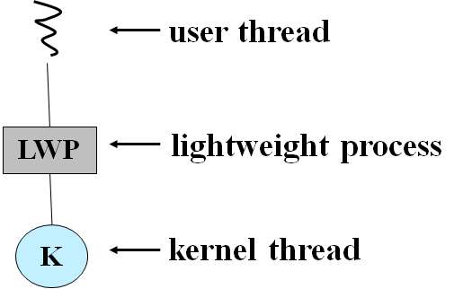
6. Scheduler Activations
Both M:M and Two-level models require communication between the kernel and the thread library to maintain the appropriate number of kernel threads allocated to the application.
Typically use an intermediate data structure between user and kernel threads – lightweight process (LWP)
Appears to be a virtual processor on which the process can schedule a user thread to run.
Each LWP attached to a kernel thread.
Typically, an LWP is required for each concurrent blocking system call.

Slide 58
Scheduler Activations
Scheduler activation -- one scheme for communication between the user-thread library and the kernel.
provides upcalls, the kernel inform an application about certain events.
upcalls are handled by the thread library with an upcall handler
upcall handlers must run on a LWP.

Slide 59
Scheduler Activations
When an application thread is about to block
kernel makes an upcall to the application, informing it, identifying the specific thread.
The kernel then allocates a new LWP to the application.
The application runs an upcall handler on this new LWP.
saves the state of the blocking thread
relinquishes the LWP the blocking thread is running on.
schedules another thread to run on the new LWP.
When the event that the blocking thread was waiting for occurs.
kernel makes another upcall to the thread library, informing it.
kernel allocates a new LWP or preempt one of the user threads to run the upcall handler for this event.
After marking the unblocked thread as eligible to run, the application schedules an eligible thread to run on an available LWP.

Slide 60
4.5 Operating-system examples
Windows Threads
Linux Threads
openEuler Threads

Slide 61
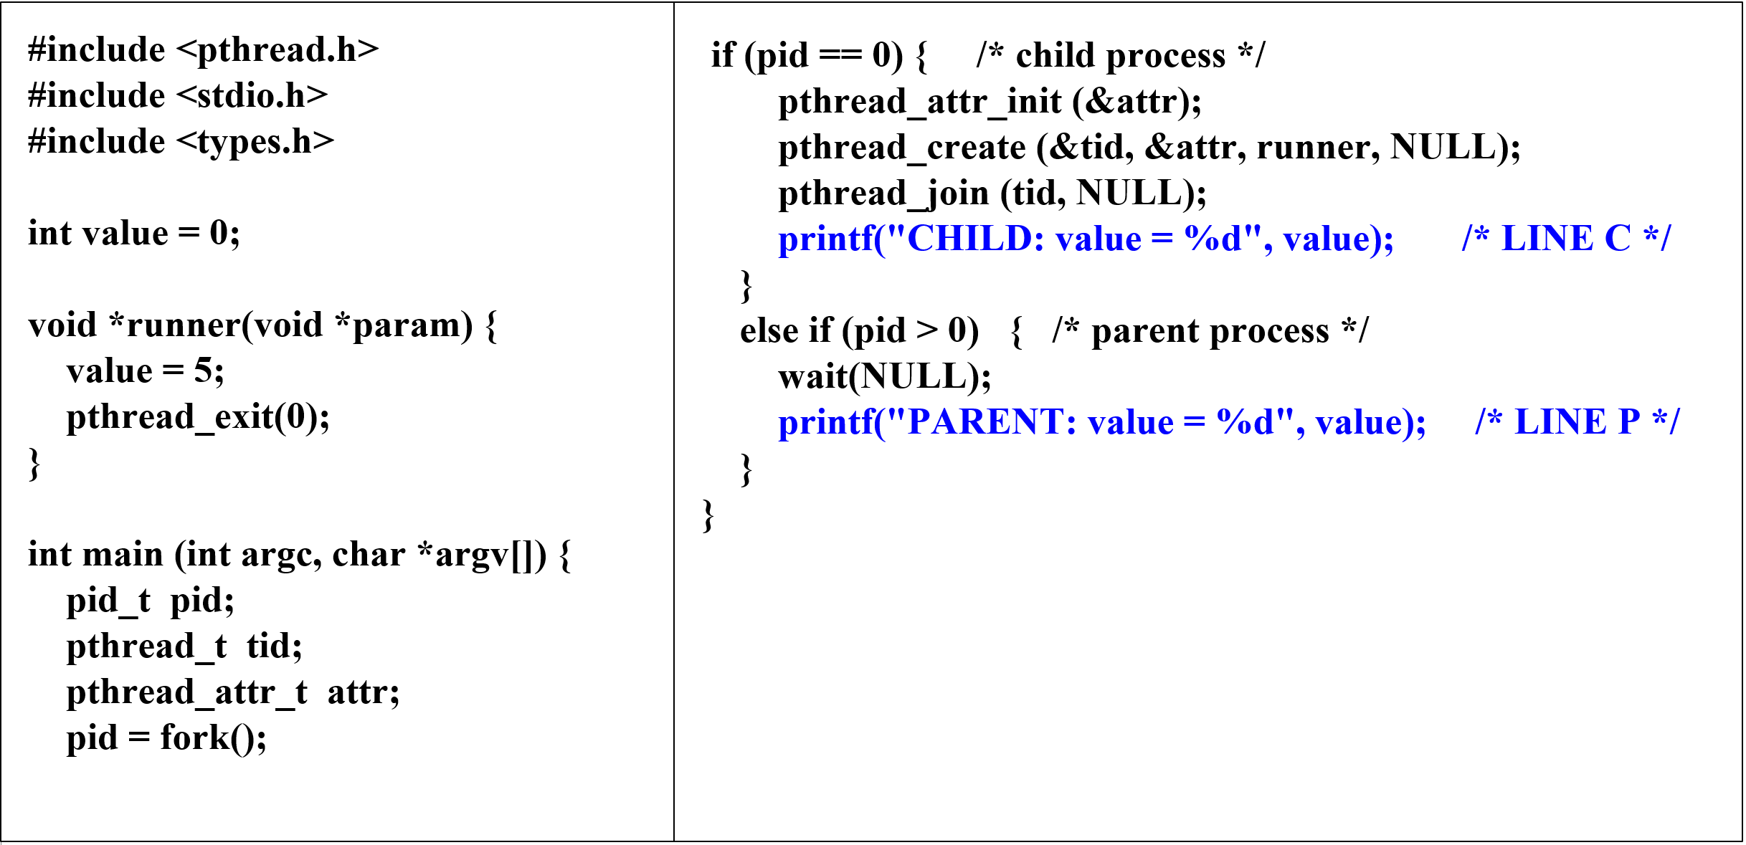
Exercise 1

Slide 62

课后作业及研究性学习
作业：掌握线程模型
实验：编程实现一个多线程程序
研究性学习：查阅实验涉及的线程库API
A1：openEuler
线程实现

Slide 63
multithreaded programming
Write a multithreaded program that calculates various statistical values for a list of numbers. This program will accept a series of numbers from the keyboard and will then create three separate worker threads. One thread will determine the average of the numbers, the second will determine the maximum value, and the third will determine the minimum value.
For example, suppose your program accepted the integers: 90 81 78 95 79 72 85 The program will report: The average value is 82 The minimum value is 72 The maximum value is 95
The variables representing the average, minimum, and maximum values will be stored globally.
The worker threads will set these values, and the parent thread will output the values once the workers have exited.

Slide 64
A1：openEuler 线程实现
openEuler 线程
openEuler中线程的实现
NPTL中的API
线程创建
线程切换

Slide 65
openEuler 线程
openEuler内核未提供专门的线程实现机制。
openEuler并未为线程提供特有的数据结构，而是复用进程的数据结构task_struct。
openEuler中，共享同一个进程地址空间的一组线程称为一个线程组。
实际上，进程由一个线程组及其共享的资源组成。
openEuler 进程和线程在地址空间中的布局：

Slide 66
openEuler中线程的实现
openEuler采用的是1:1模型，其向用户提供的线程库是NPTL.
线程的生命周期:

Slide 67
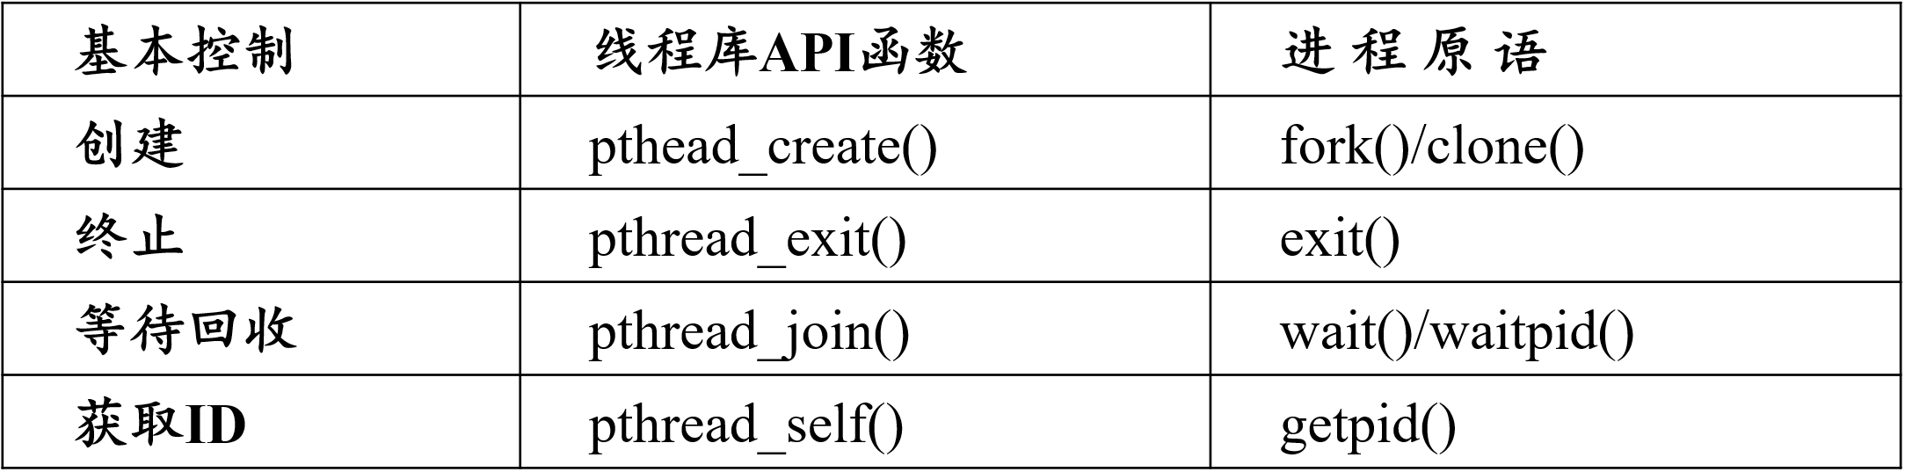
NPTL中的API
NPTL中的API函数最终会调用内核提供给用户空间的系统调用接口，进而借助内核中的原语，完成线程控制。
openEuler没有为线程定义原语，使用进程原语对其控制，所以NPTL中的函数最终对应的是进程原语。
对应关系：

Slide 68
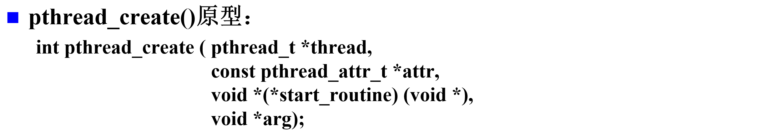
线程创建
首先配置线程的用户空间环境，包括线程属性、用户栈空间及线程描述符等信息；
调用函数create_thread()，进而调用do_clone()去请求内核创建一个内核级线程。
内核在接收到线程创建请求后，将调用内核函数sys_clone()，最终调用函数_do_fork()完成内核级线程的创建。

Slide 69
pthread_create()的创建流程

Slide 70
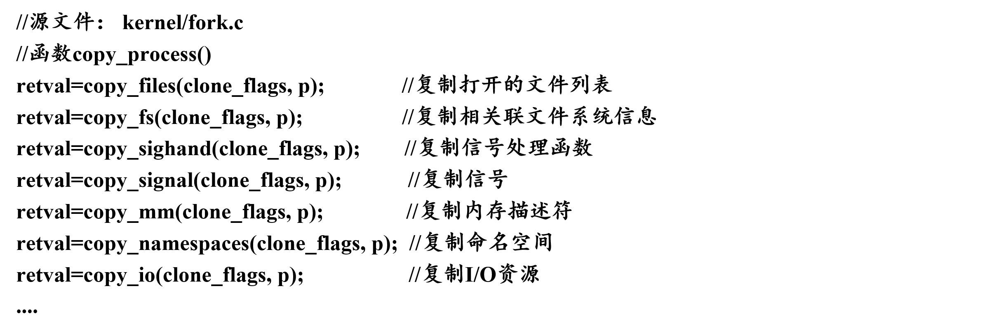
copy_process()：实现资源复制

Slide 71
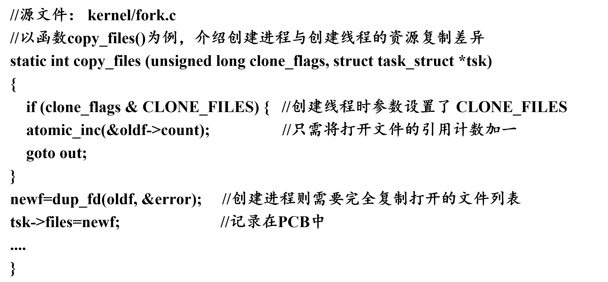
copy_process()：实现资源复制

Slide 72
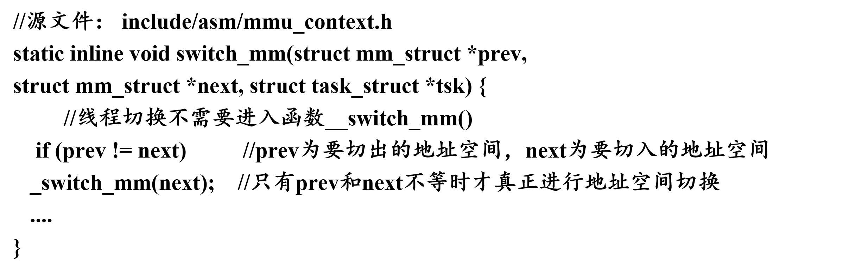
线程切换
三个主要步骤： 地址空间切换、内核栈切换和上下文切换。

Slide 73
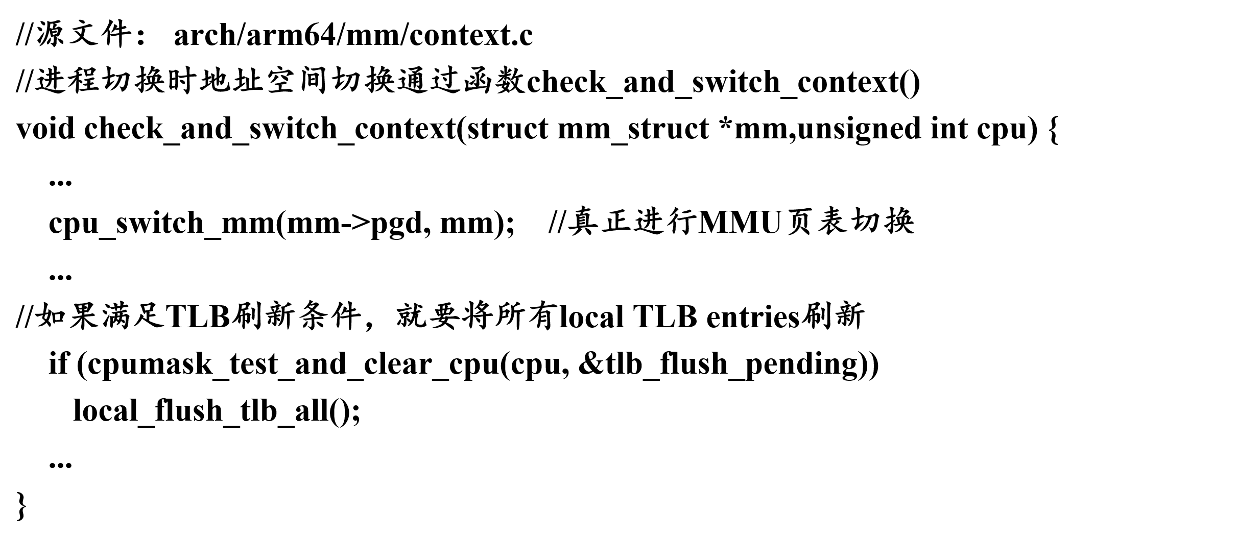
线程切换

